Slide 1
SeqTec 2021 – Multiome experiment
Goal: Use a sample barcoding strategy called ‘SnuBar’ to run a 10X Genomics Multiome (RNA + ATAC) experiment with multiple biological samples
Cell Line: NIH-3T3 fibroblasts
Treatments: IL-1b, TGFb, IFNg, LIF, TNFa
Pairwise combinations of several factors (12 samples total)
Demultiplex samples with CITE-seq-Count and Hashsolo

Slide 2
IL1b
Inflammatory
Fibroblasts
???
Resting Fibroblasts
TGFb
Antigen Presenting Fibroblasts
???
Myofibroblasts
TGFb
IFNg
???
???

Slide 3
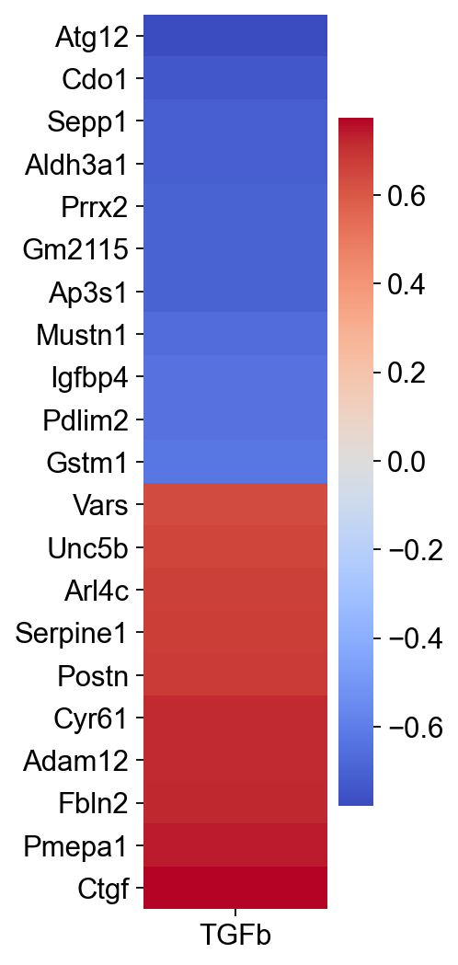
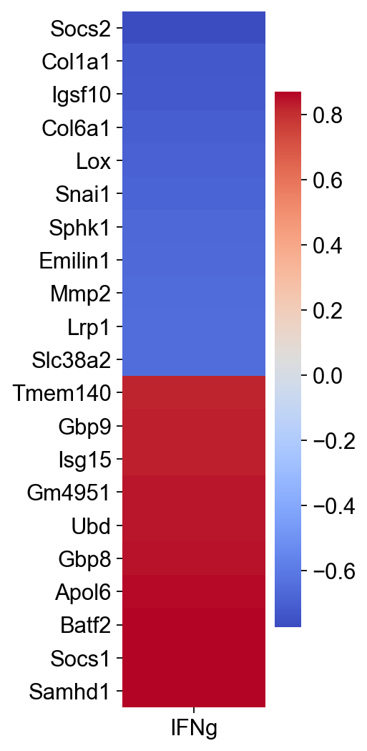
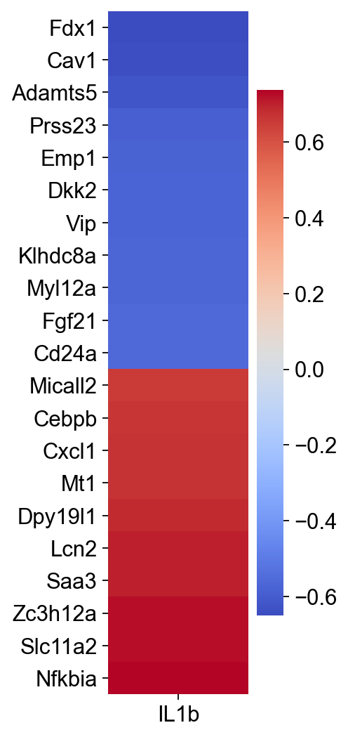

Slide 4
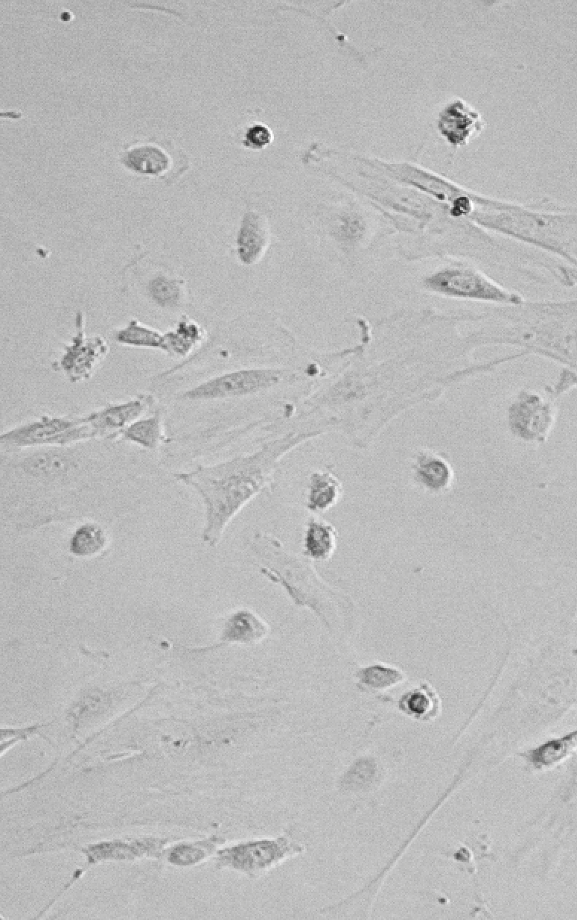
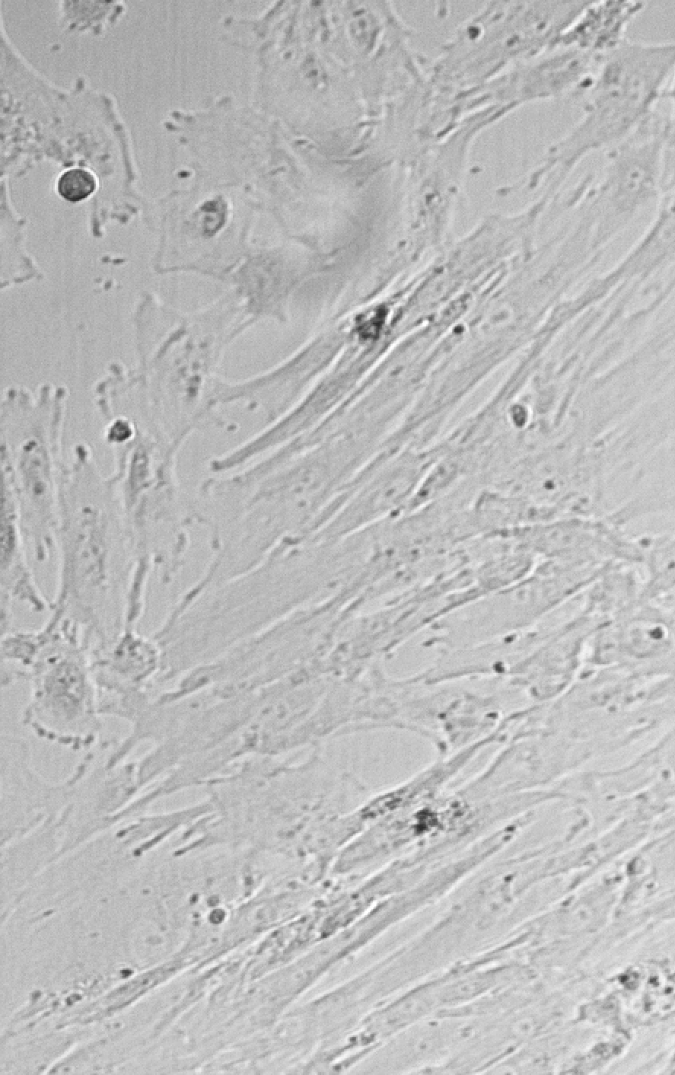
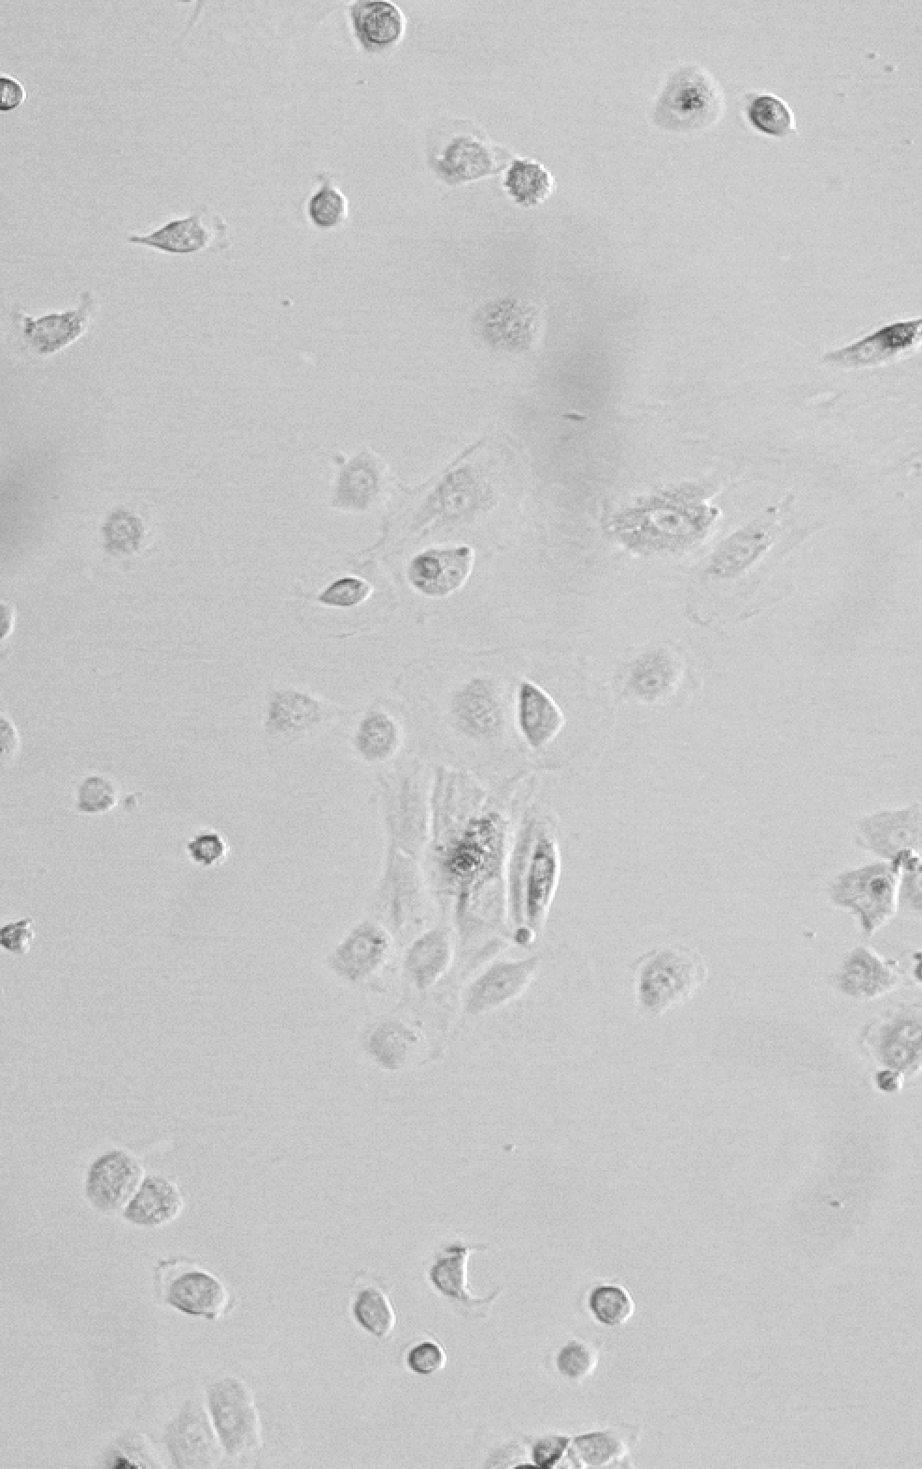
Control
TGFβ
IFNγ

Slide 5
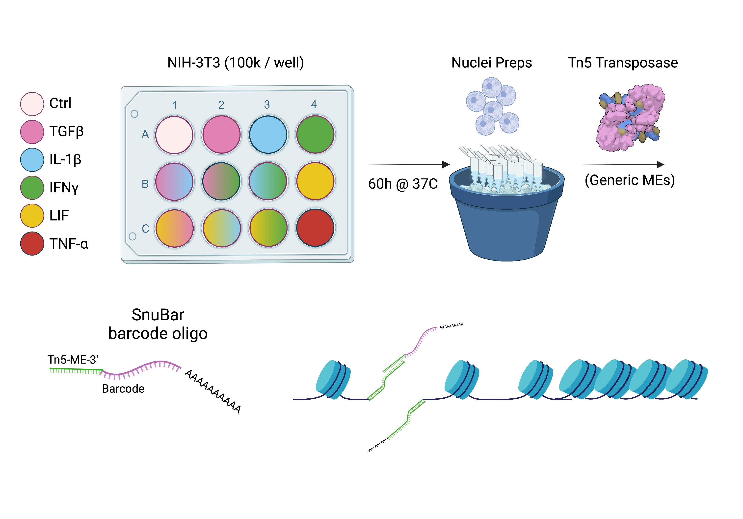

Slide 6
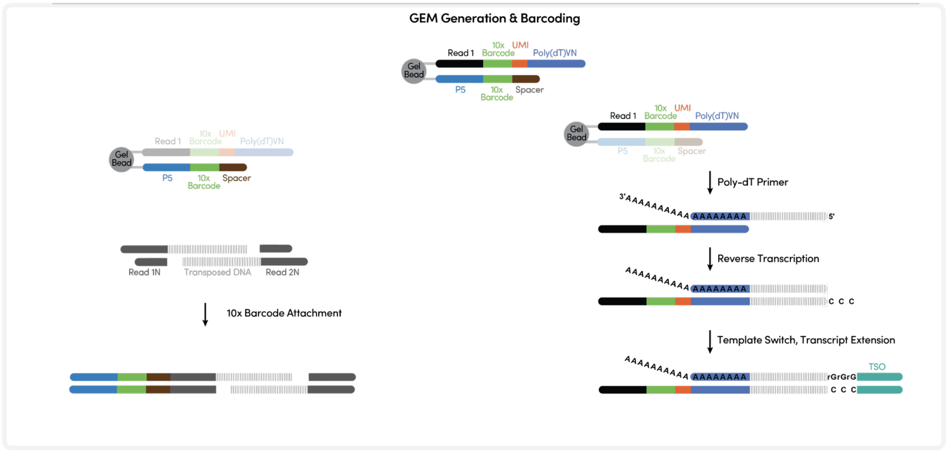

Slide 7
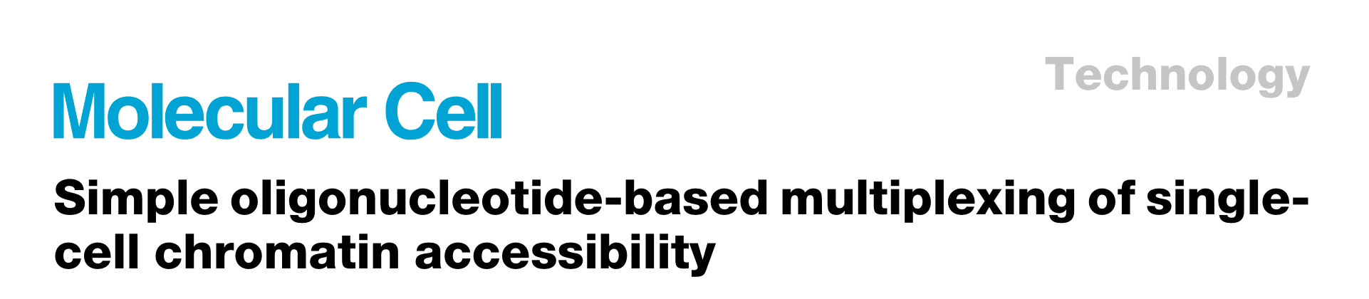
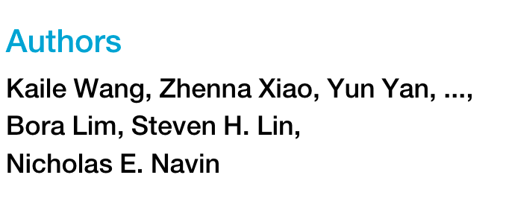
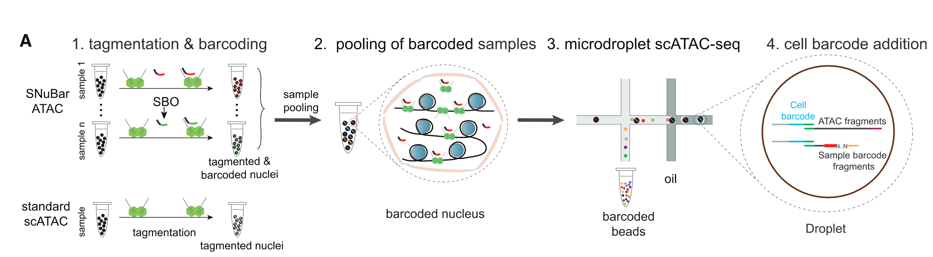
Snu-Bar

Slide 8
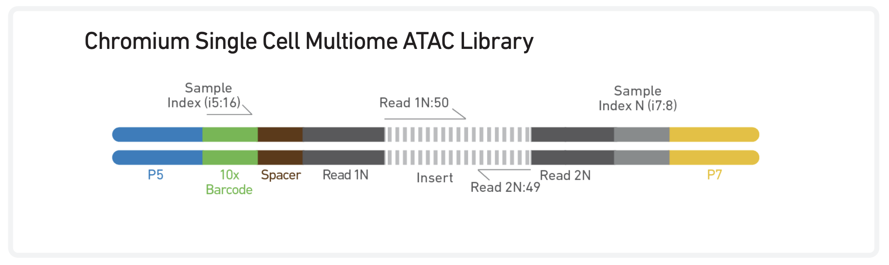
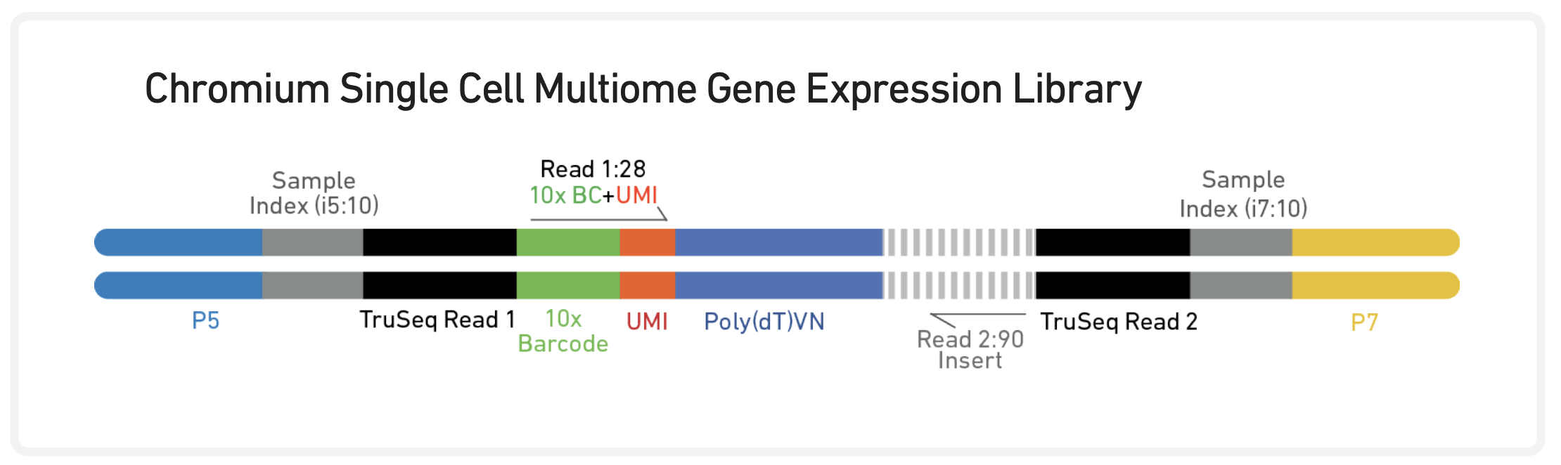
Sequencing Requirements
 | Read 1 | I7 | I5 | Read 2
10X. Rec | 50 | 8 | 16 | 49
Min.* | 30 | 8 | 16 | 30
*NextSeq500 SE75 compatible
 | Read 1 | I7 | I5 | Read 2
10X. Rec | 28 | 8 | n/a | 49
Min. * | 28 | 8 | n/a | 56
*NextSeq500 SE75 compatible

Slide 9
5’ TTTCTTATATGGGAGATGTGTATAAGAGACAG 3’
3’ AAAGAATATACCCTCTACACATATTCTCTGTC-/5phos/
5’ GTCTCGTGGGCTCGGAGATGTGTATAAGAGACAG 3’
3’ CAGAGCACCCGAGCCTCTACACATATTCTCTGTC-/5phos/
Nextera Tn5
Illumina Small RNA primer
10bp
Barcode
Tn5 handle
CGAGCCCACGAGAC CCTTGGCACCCGAGAATTCCA GCCTCTTTGT AAAAAAAAAAAAAAAAAAAAAAAAAAAAAA Snubar1
CGAGCCCACGAGAC CCTTGGCACCCGAGAATTCCA CAGGGATGGT AAAAAAAAAAAAAAAAAAAAAAAAAAAAAA Snubar2
CGAGCCCACGAGAC CCTTGGCACCCGAGAATTCCA CTACTGCCGA AAAAAAAAAAAAAAAAAAAAAAAAAAAAAA Snubar3
SNU
smRNA
Tn5
i7
P7

Slide 10
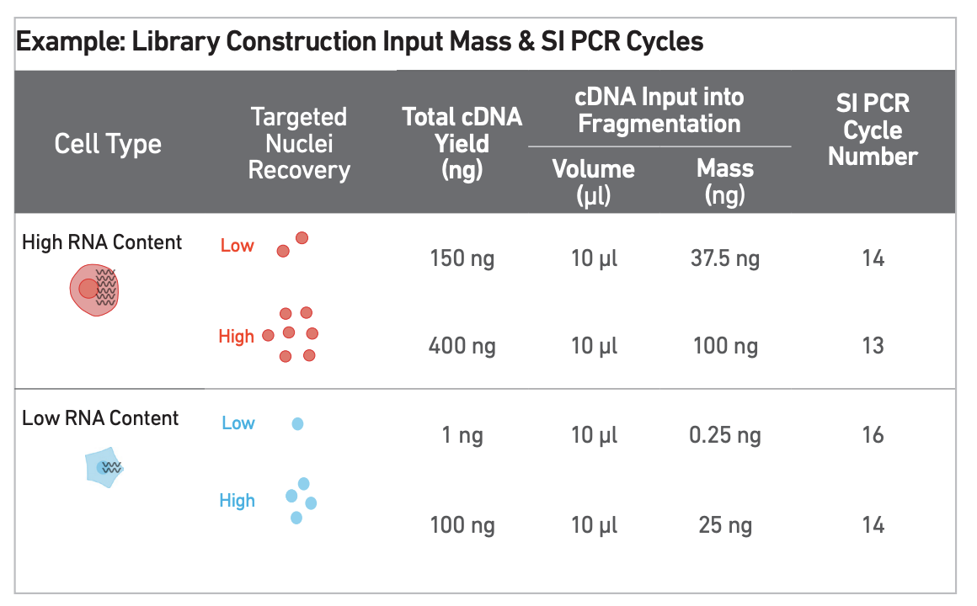
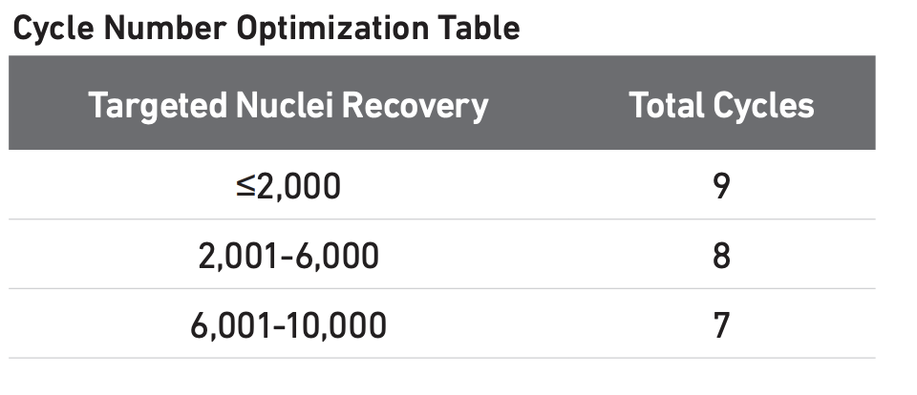
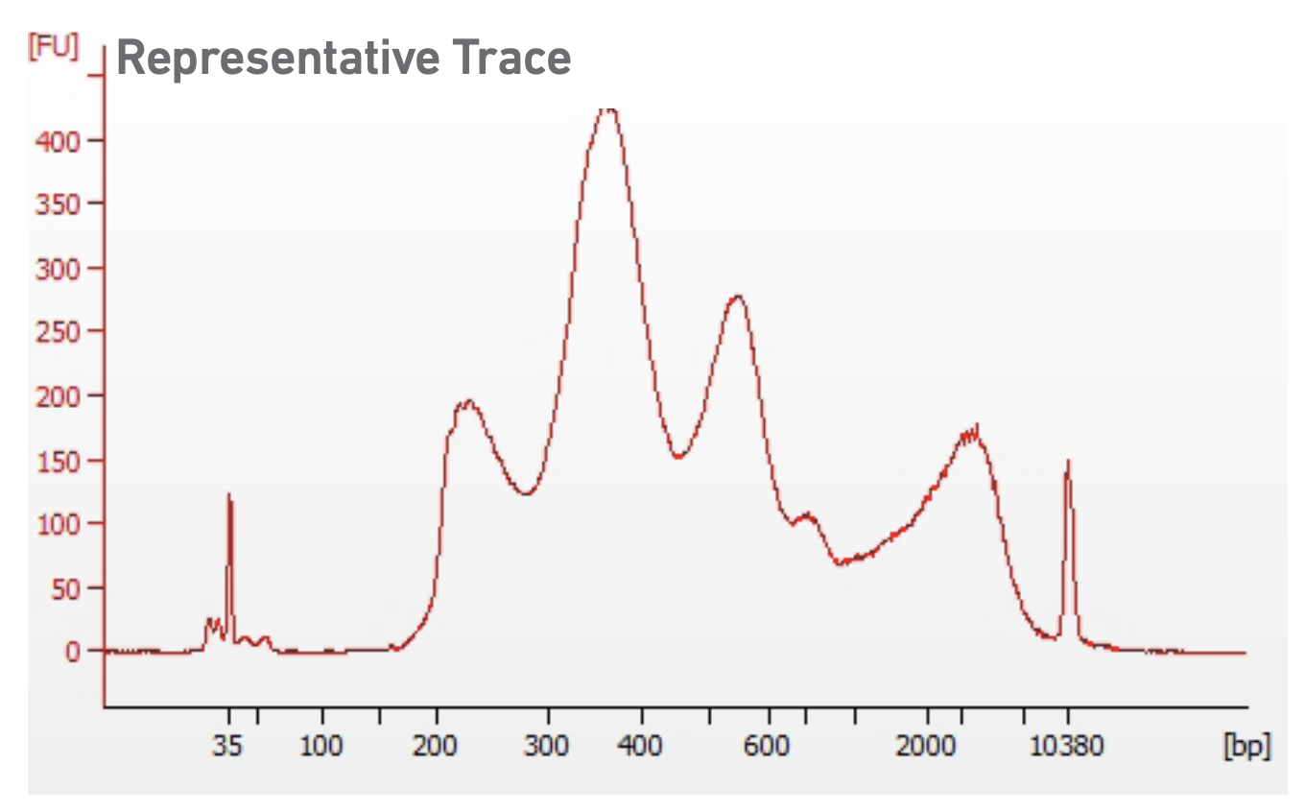
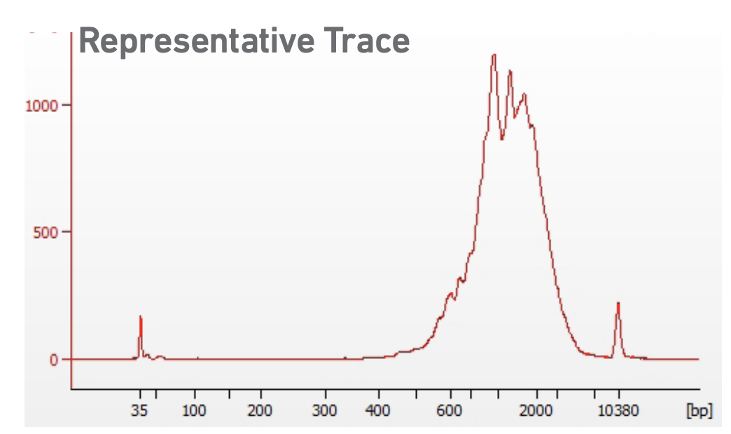
Multiome Library QC

Slide 11
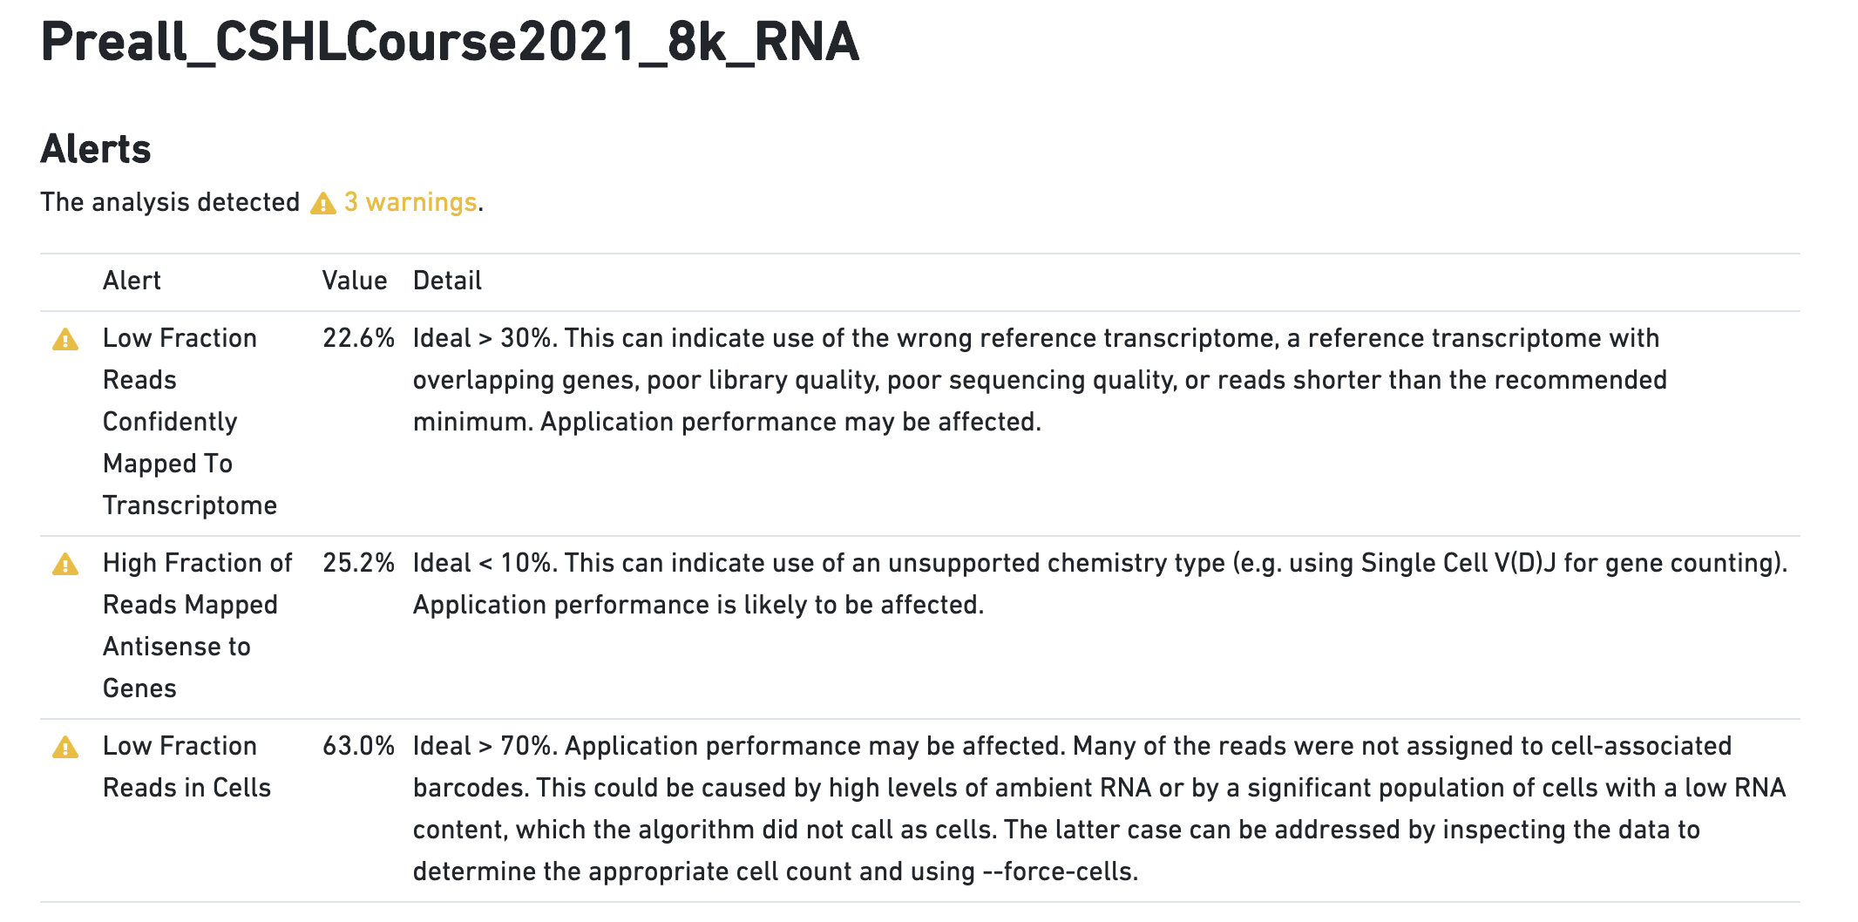

Slide 12
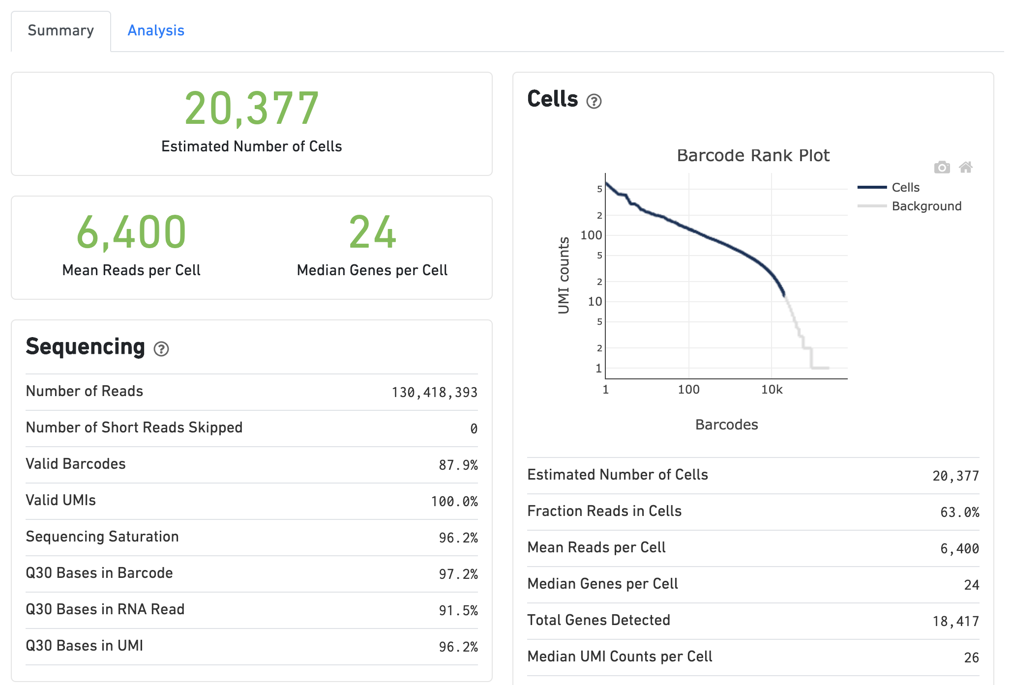

Slide 13
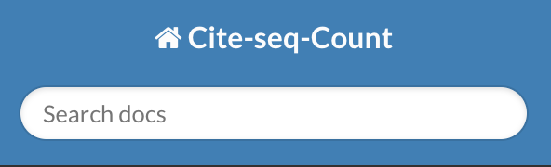

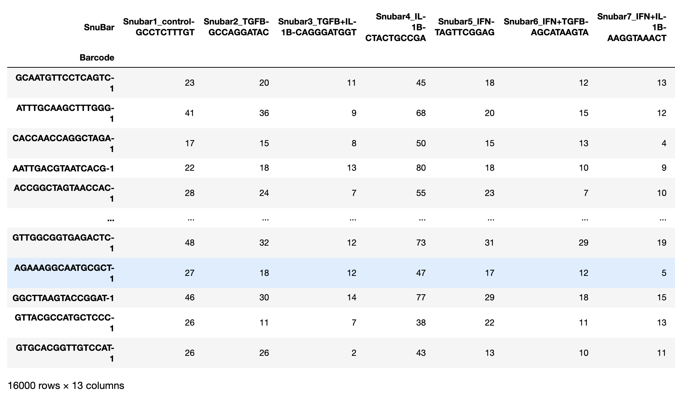
Count Snubars and import into Scanpy
hashdir=/Volumes/mccombie/Illumina_runs/NextSeqData/NextSeqOutput/211117_NB551387_0662_AHLK7WBGXK/NGS-CR-2140/
SAMPLE=Preall_CSHLCourse2021_16k_snubar
R1_FASTQ=$(ls $hashdir/$SAMPLE*_R1_*)
R2_FASTQ=$(ls $hashdir/$SAMPLE*_R2_*)
CITE-seq-Count \
-R1 $R1_FASTQ \
-R2 $R2_FASTQ \
-t hash_tags.csv \
-cbf 1 \
-cbl 16 \
-umif 17 \
-umil 28 \
-o "$SAMPLE"_Result.tsv \
-cells 16000
features.tsv.gz
barcodes.tsv.gz
matrix.mtx.gz
Read in Snubar counts into scanpy -> create Anndata object

Slide 14
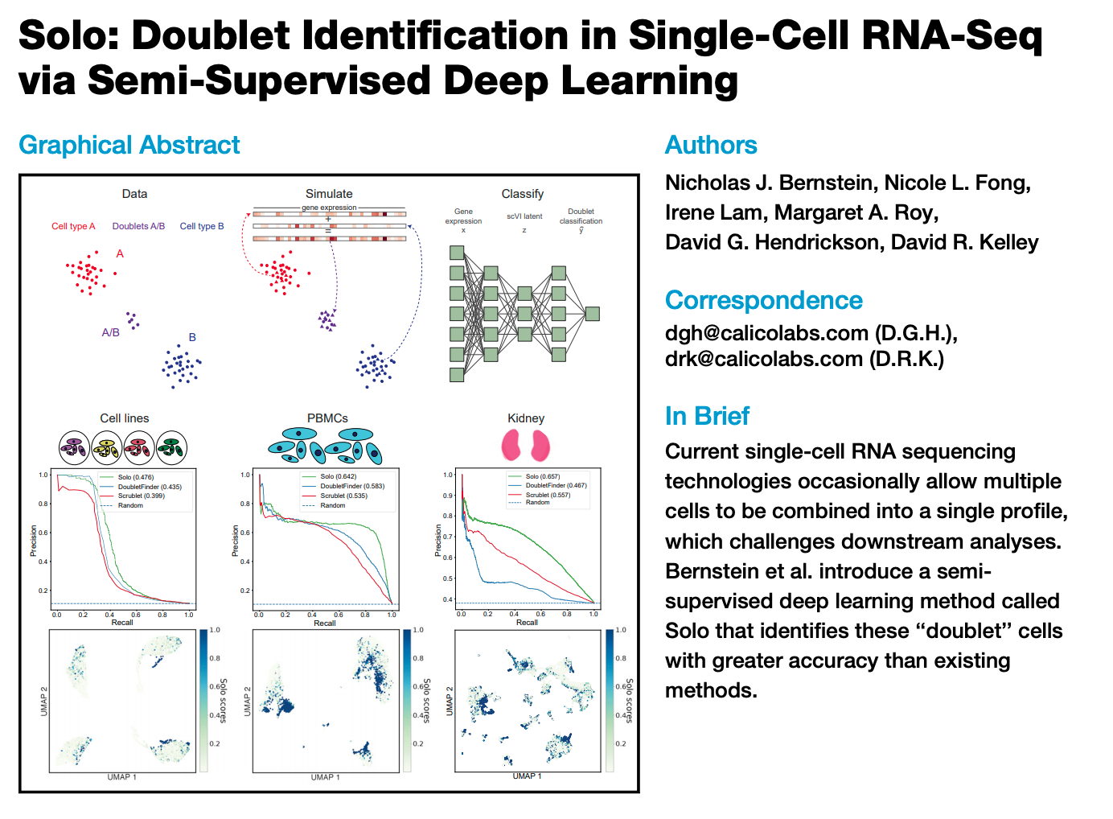
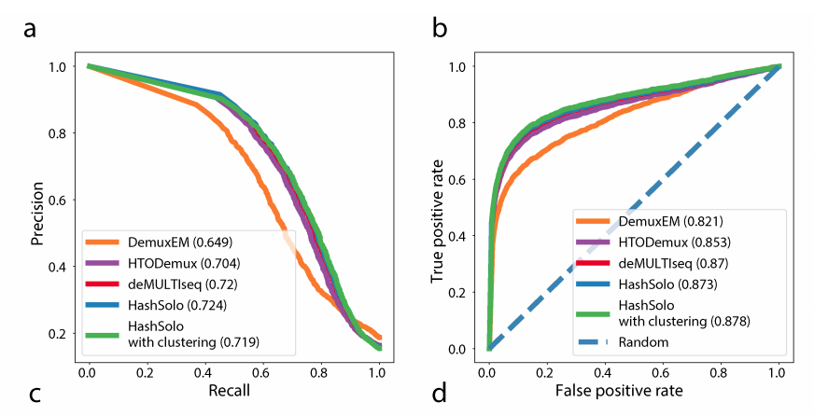
Demultiplex with Hashsolo
>>> from solo import hashsolo
>>> import anndata
>>> cell_hashing_data = anndata.read("cell_hashing_counts.h5ad")
>>> hashsolo.hashsolo(cell_hashing_data)
>>> cell_hashing_data.obs.head()
most_likeli_hypothesis cluster_feature negative_hypothesis_probability singlet_hypothesis_probability doublet_hypothesis_probability Classification
index
CCTTTCTGTCCGAACC 2 0 1.203673e-16 0.000002 0.999998 Doublet
CTGATAGGTGACTCAT 1 0 1.370633e-09 0.999920 0.000080 BatchF-GTGTGACGTATT_x
AGCTCTCGTTGTCTTT 1 0 2.369380e-13 0.996992 0.003008 BatchE-GAGGCTGAGCTA_x
GTGCGGTAGCGATGAC 1 0 1.579405e-09 0.999879 0.000121 BatchB-ACATGTTACCGT_x
AAATGCCTCTAACCGA 1 0 1.867626e-13 0.999707 0.000293 BatchB-ACATGTTACCGT_x
>>> demultiplex.plot_qc_checks_cell_hashing(cell_hashing_data)

